Slide 1

Software requirements (swr302)
The business analyst (chapter 04)

Slide 2
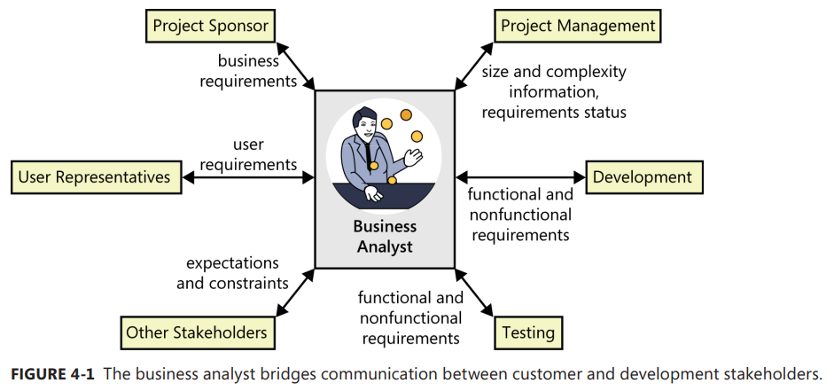
The business analyst role

Slide 3
The business analyst’s tasks
Define business requirements
Plan the requirements approach
Identify project stakeholders and user classes
Elicit requirements
Analyze requirements
Document requirements
Communicate requirements
Lead requirements validation
Facilitate requirements prioritization
Manage requirements

Slide 4
Essential analyst skills
Listening skills
Interviewing and questioning skills
Thinking on your feet
Analytical skills
Systems thinking skills
Learning skills
Facilitation skills
Leadership skills
Observational skills
Communication skills
Organizational skills
Modeling skills
Interpersonal skills
Creativity

Slide 5
Essential analyst knowledge
need a breadth of knowledge, much of which is gained through experience.
need to understand contemporary requirements engineering practices and how to apply them in the context of various software development life cycles.
need to educate and persuade those who are not familiar with established requirements practices.
the effective analyst has a rich tool kit of techniques available and knows when—and when not—to use each one.
understanding of project management, development life cycles, risk management, and quality engineering
analyst can minimize miscommunications with users
understand the organization and business domains often detect unstated assumptions and implicit requirements
suggest ways that users could improve their business processes or propose valuable functionality that no other stakeholder thought of

Slide 6
The making of a business analyst
The former user
The former developer or tester
The former (or concurrent) project manager
The subject matter expert
The rookie

Slide 7
The analyst role on agile projects
Define a lightweight, flexible requirements process and adapt it as the project warrants.
Ensure that requirements documentation is at the right level: not too little and not too much
Help determine the best approach to document the backlog, including whether story cards or more formal tools are most appropriate.
Apply facilitation and leadership skills to ensure that stakeholders are talking to one another frequently about requirements needs, questions, and concerns.
Help validate that customer needs are accurately represented in the product backlog, and facilitate backlog prioritization
Work with customers when they change their minds about requirements and priorities, and help record those changes.
Work with the rest of the team to determine the impact of changes on iteration contents and release plans

Slide 8


